Slide 1

Collecting the Data

Slide 2
Objectives
Data Collection with Web Scraping
Implement the Data Collection with Web Scraping
Collecting the Data

Slide 3
Data Collection with Web Scraping
Student stask: import and complete the following Jupyter notebook in IBM Watson Studio:
→ jupyter-labs-webscraping.ipynb
Objectives
  Web scrap Falcon 9 launch records with BeautifulSoup:Extract a Falcon 9 launch records HTML table from Wikipedia
  Parse the table and convert it into a Pandas data frame
Collecting the Data
Notes:
https://cf-courses-data.s3.us.cloud-object-storage.appdomain.cloud/IBM-DS0321EN-SkillsNetwork/labs/module_1_L2/jupyter-labs-webscraping.ipynb

Slide 4
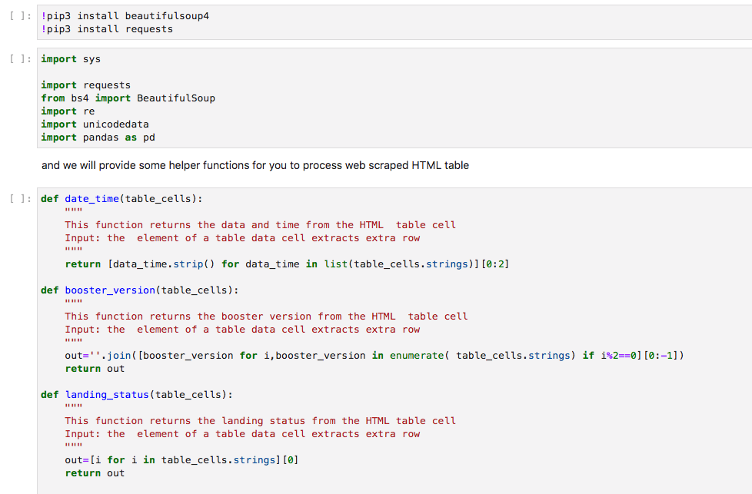
Implement the Data Collection with Web Scraping
Collecting the Data

Slide 5
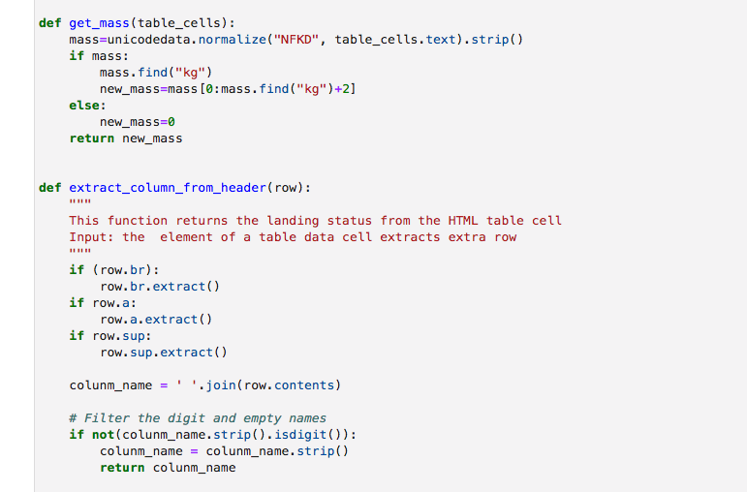
Implement the Data Collection with Web Scraping
Collecting the Data

Slide 6
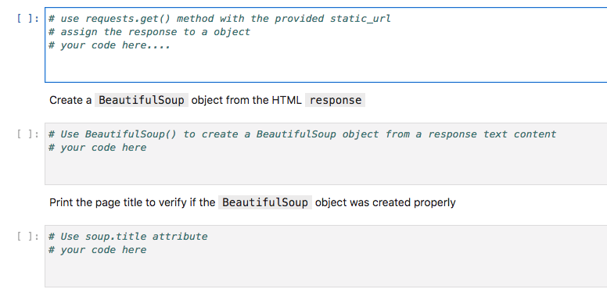
Implement the Data Collection with Web Scraping
TASK 1: Request the Falcon9 Launch Wiki page from its URL
Collecting the Data

Slide 7
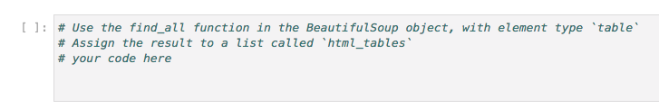
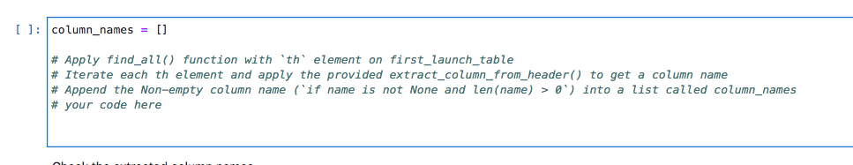
Implement the Data Collection with Web Scraping
TASK 2: Extract all column/variable names from the HTML table header
Collecting the Data

Slide 8
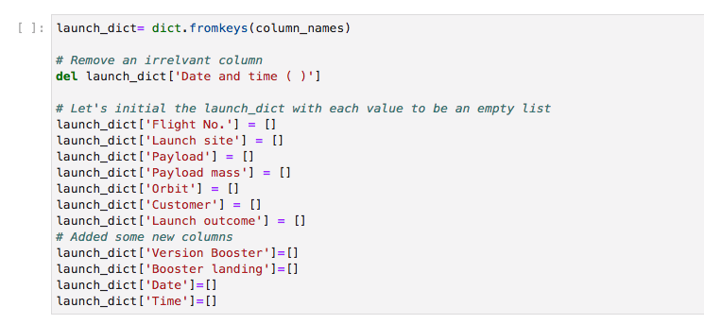
Implement the Data Collection with Web Scraping
TASK 3: Create a data frame by parsing the launch HTML tables
Collecting the Data

Slide 9
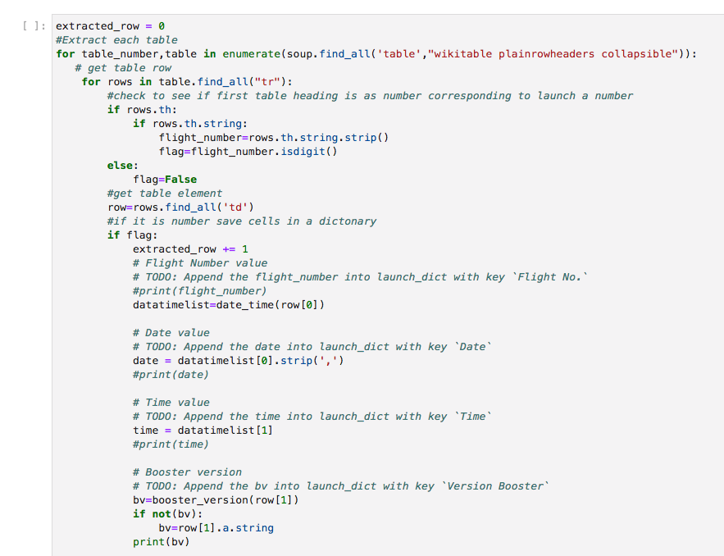
Implement the Data Collection with Web Scraping
Collecting the Data

Slide 10
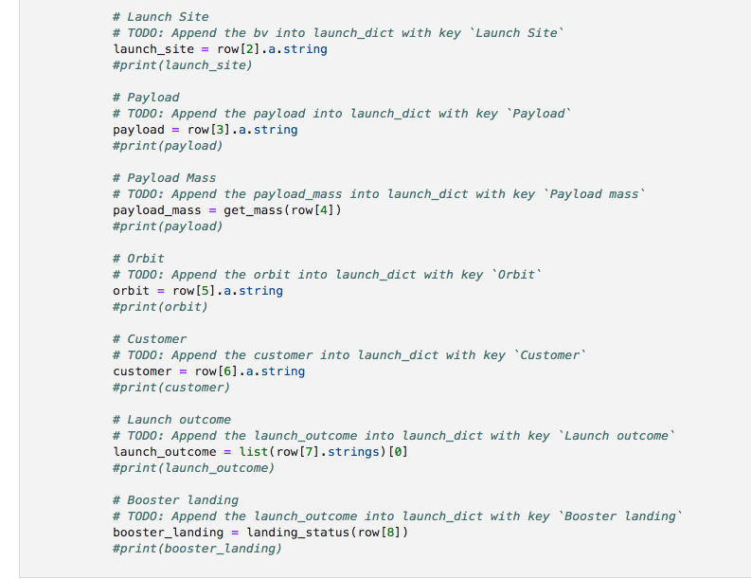
Implement the Data Collection with Web Scraping
Collecting the Data

Slide 11


Implement the Data Collection with Web Scraping
Create a dataframe
Export to a CSV
Collecting the Data

Slide 12
Summary
Data Collection with Web Scraping
Implement the Data Collection with Web Scraping
Collecting the Data

Slide 13
Q & A
Collecting the Data

